Slide 1
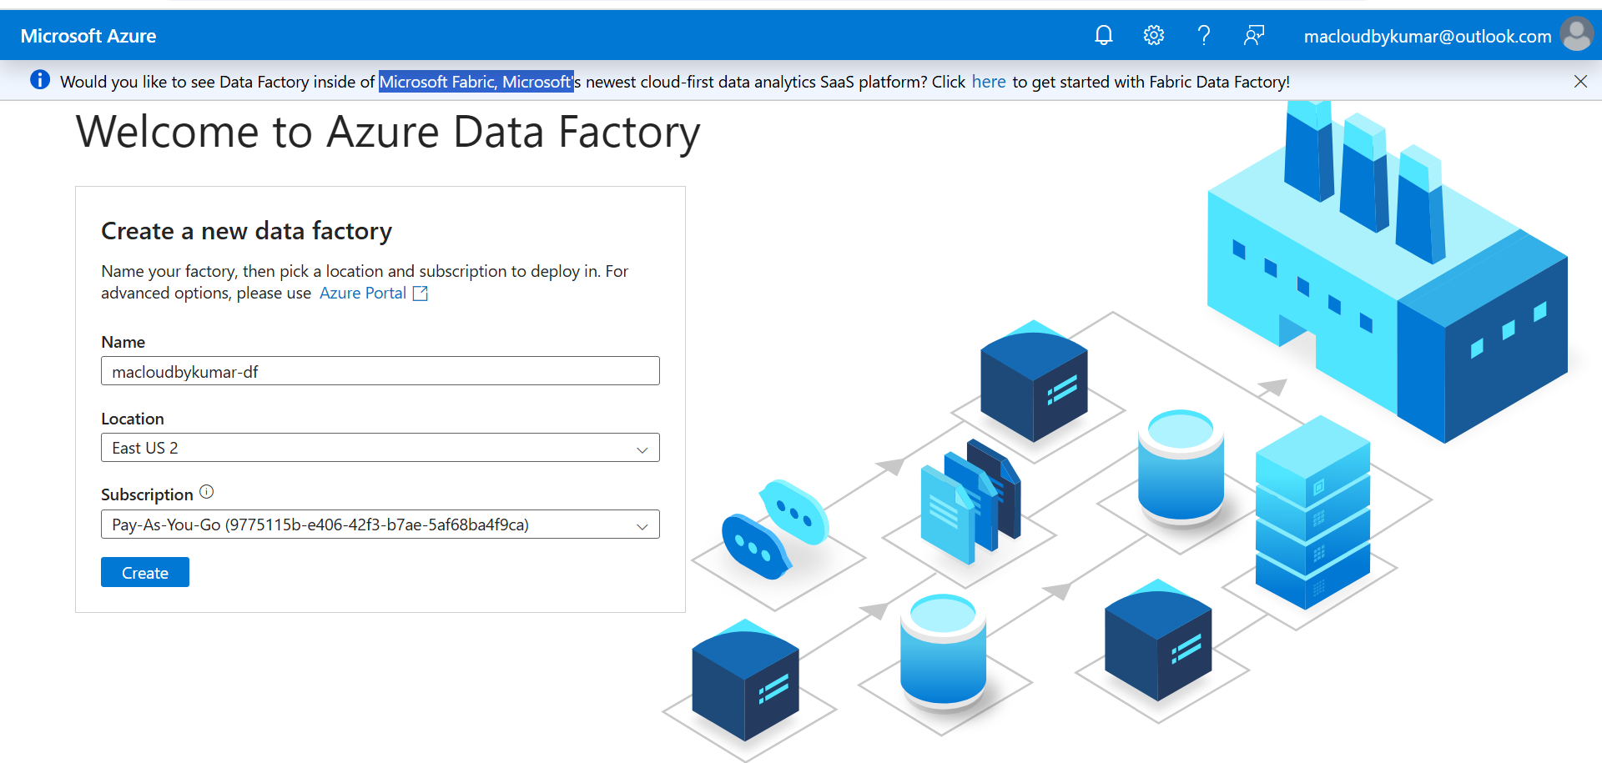
Notes:
https://learn.microsoft.com/en-us/training/modules/intro-to-azure-data-factory/3-how-azure-data-factory-works

Slide 2
https://learn.microsoft.com/en-us/azure/data-factory/quickstart-create-data-factory?wt.mc_id=searchAPI_azureportal_inproduct_rmskilling&sessionId=6461177abeb144dea4897152078d7f97

Slide 3
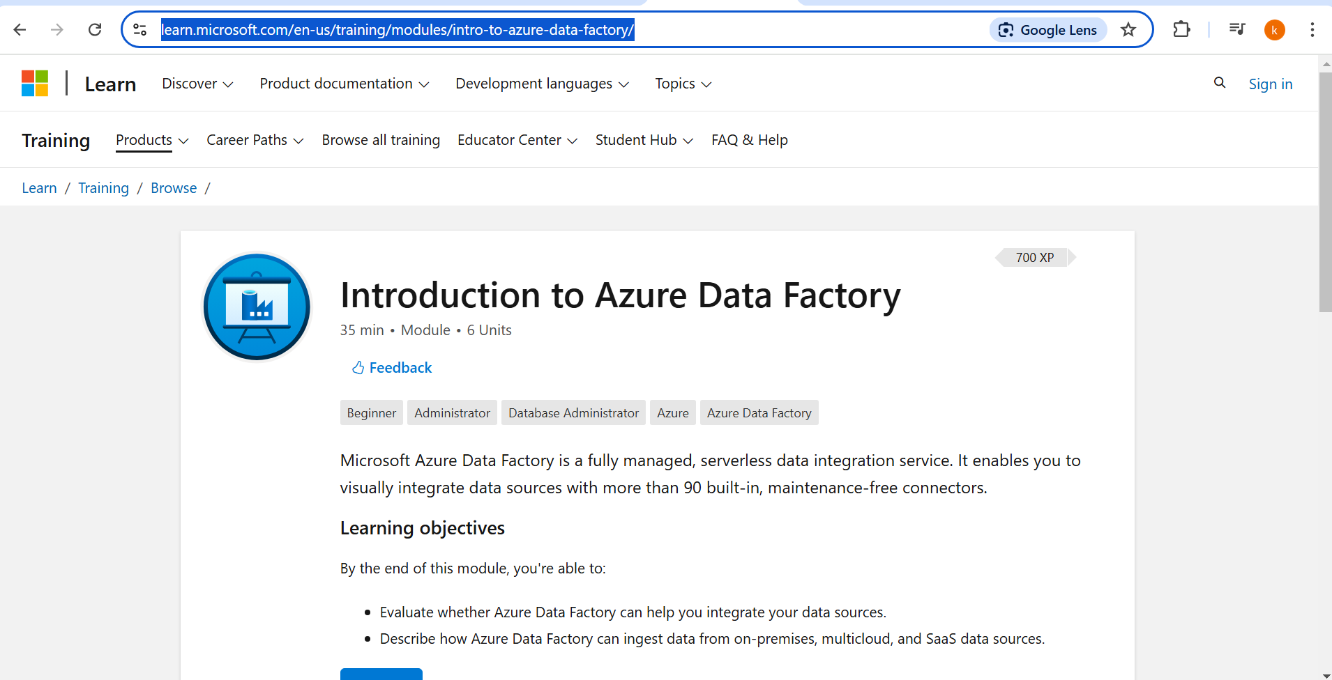
Notes:
https://learn.microsoft.com/en-us/training/modules/intro-to-azure-data-factory/

Slide 4
https://raw.githubusercontent.com/djpmsft/adf-ready-demo/master/moviesDB.csv
Notes:
https://raw.githubusercontent.com/djpmsft/adf-ready-demo/master/moviesDB.csv

Slide 5
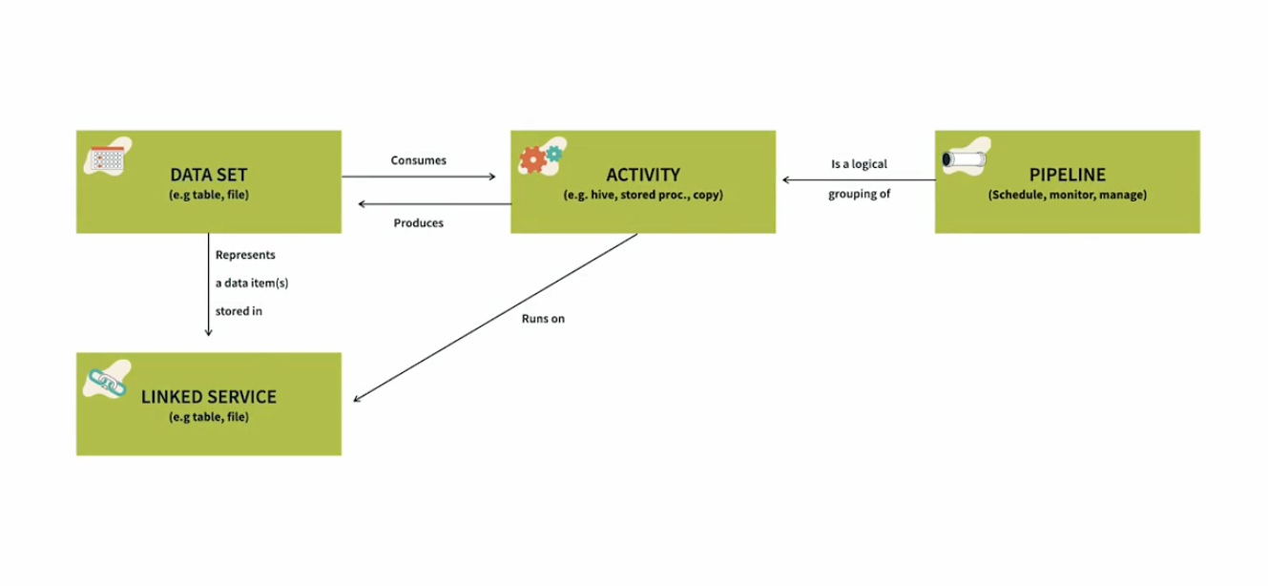

Slide 6
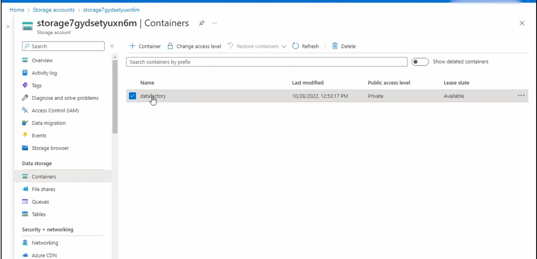

Slide 7
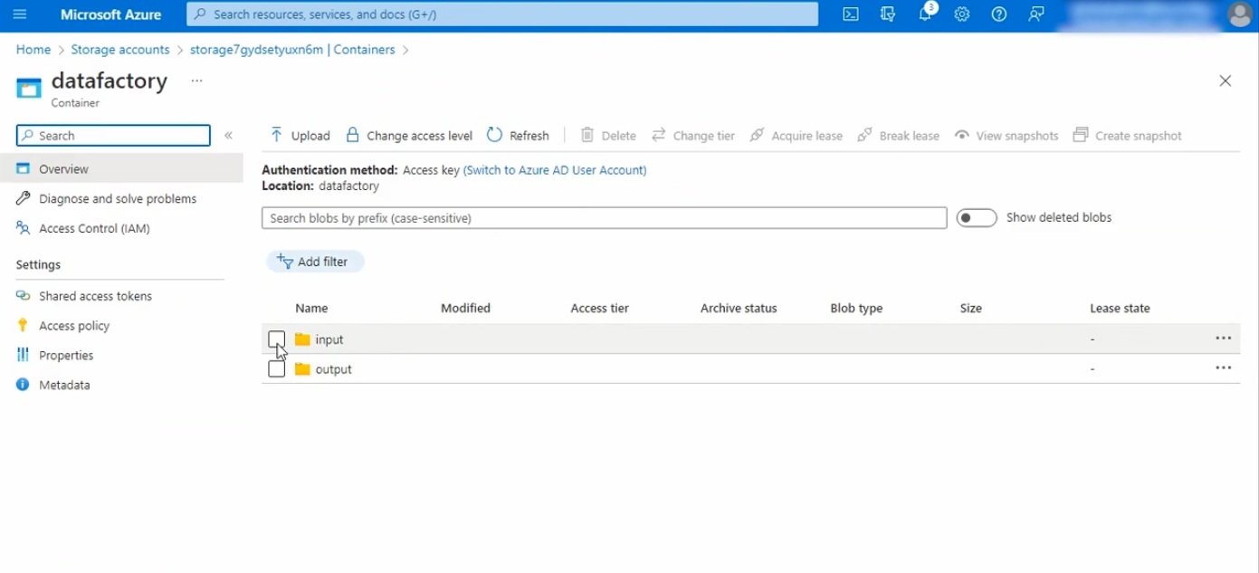

Slide 8
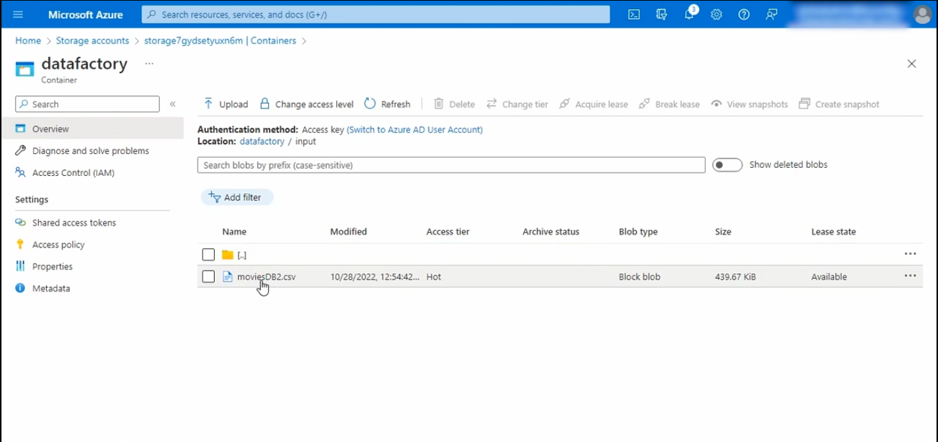

Slide 9
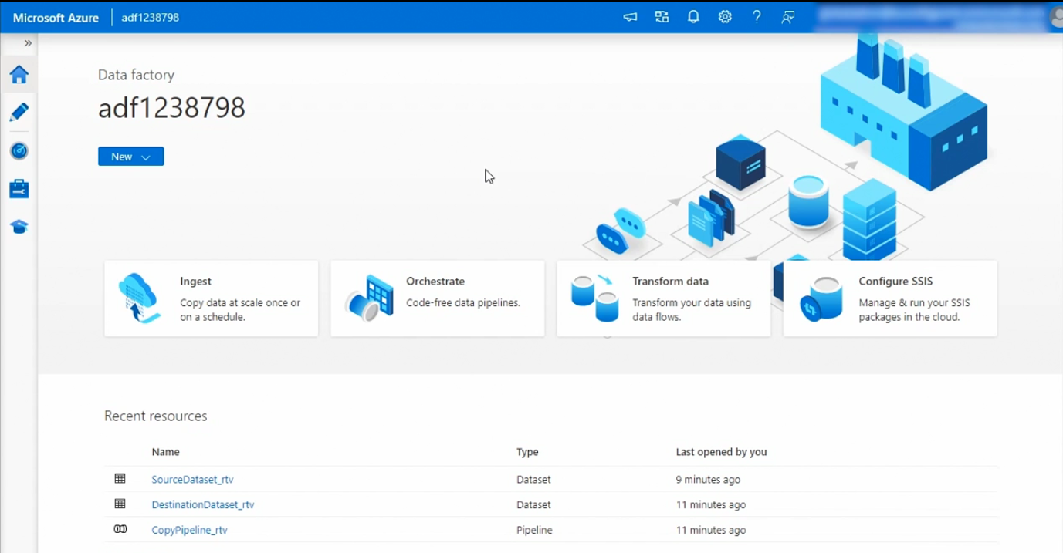

Slide 11
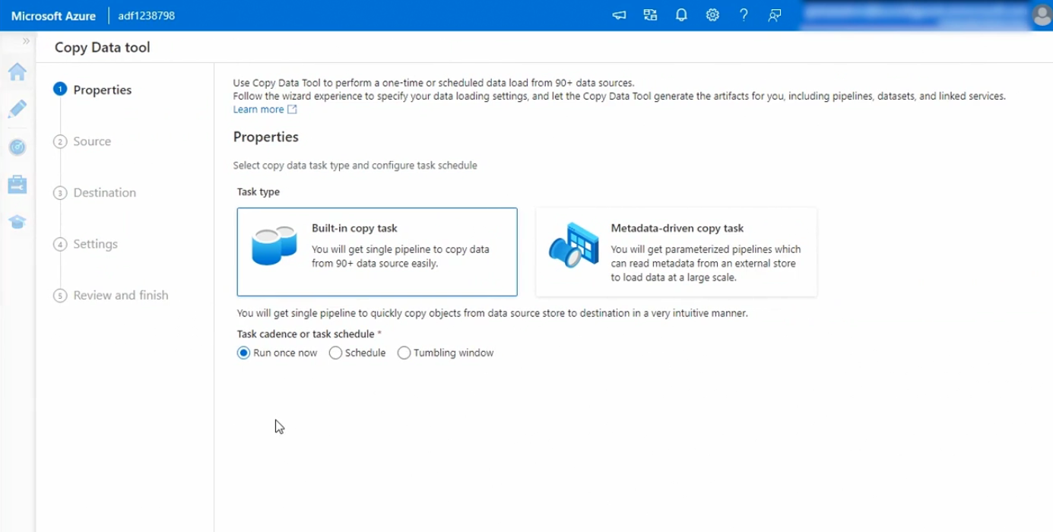

Slide 12
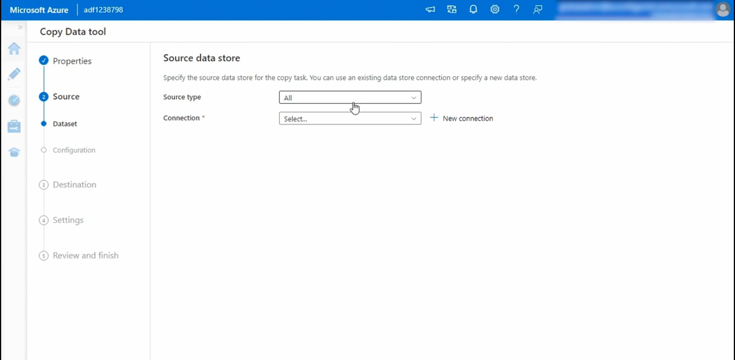

Slide 13
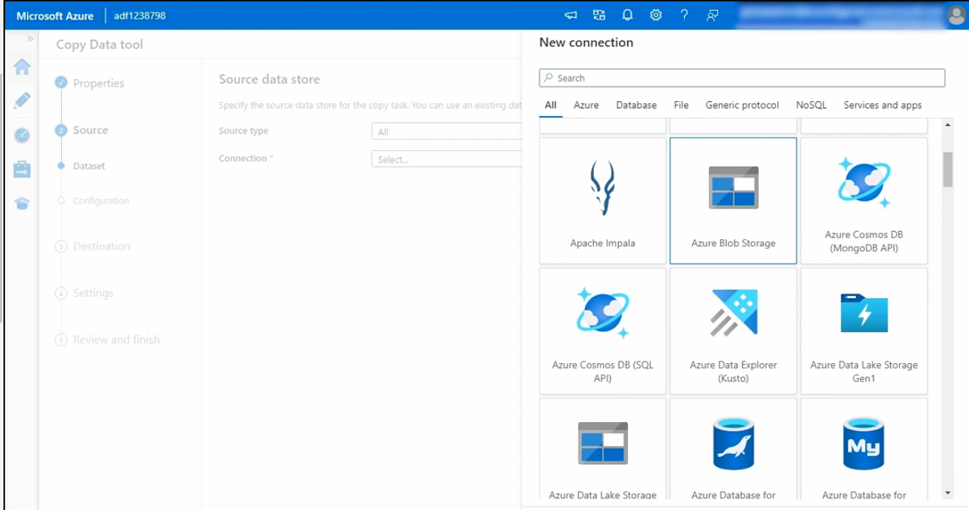

Slide 14
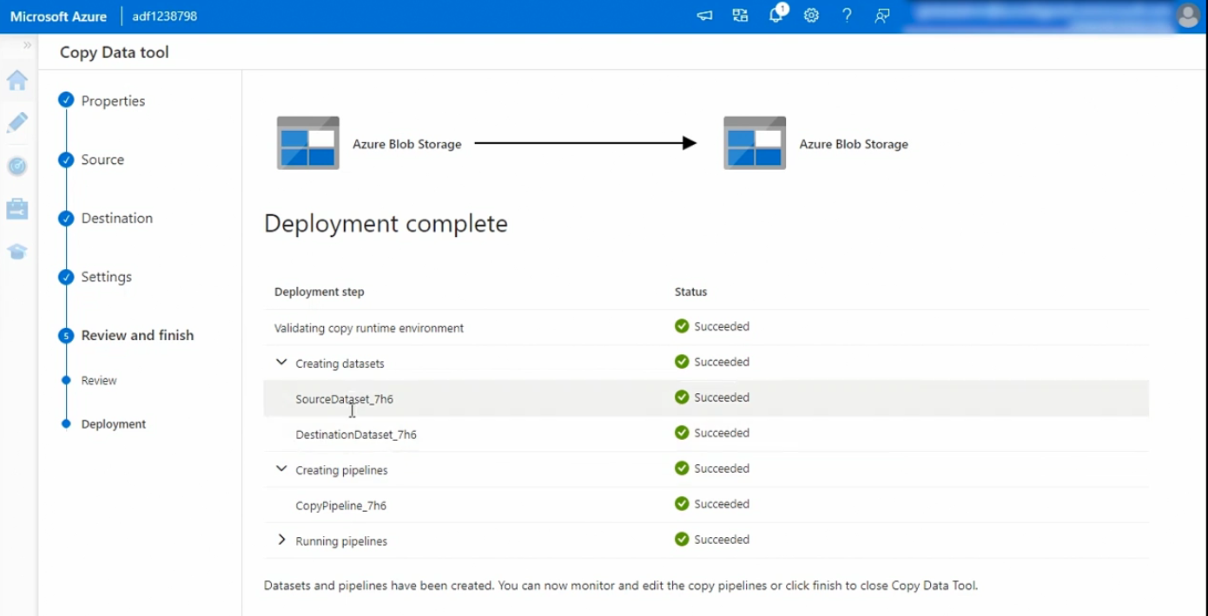

Slide 15
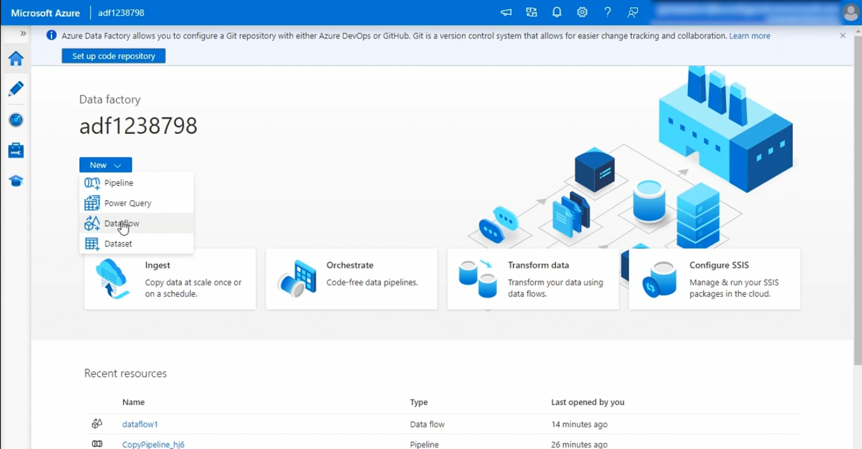

Slide 16
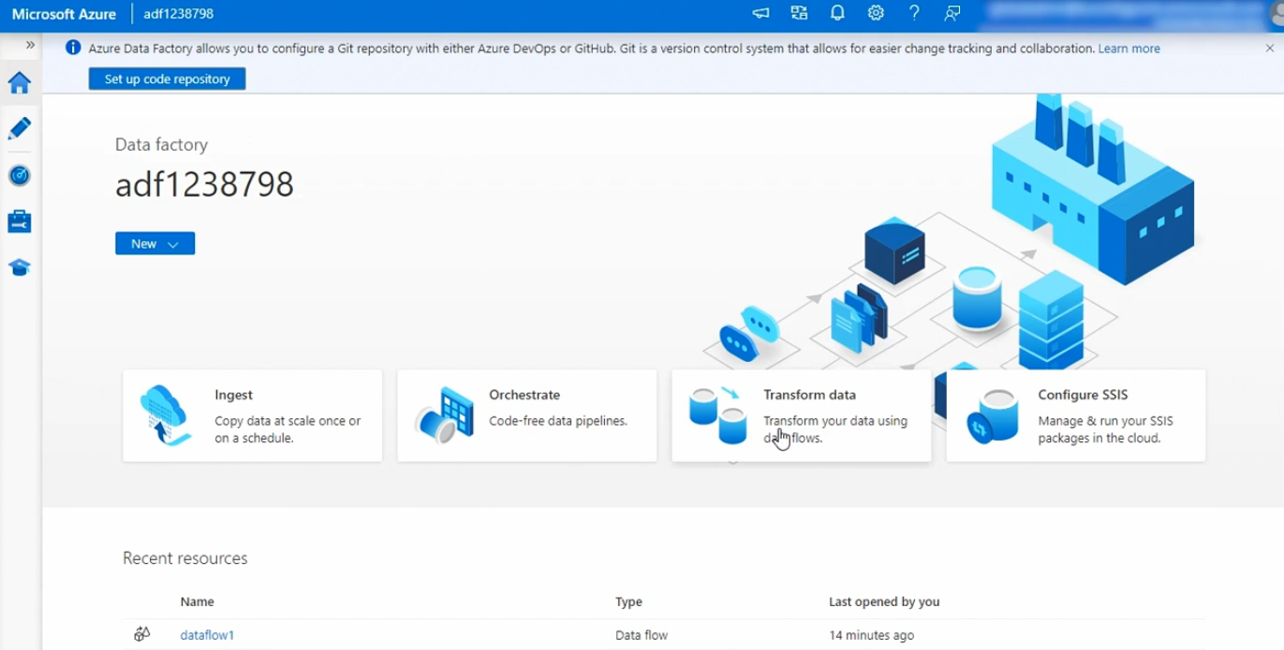

Slide 17
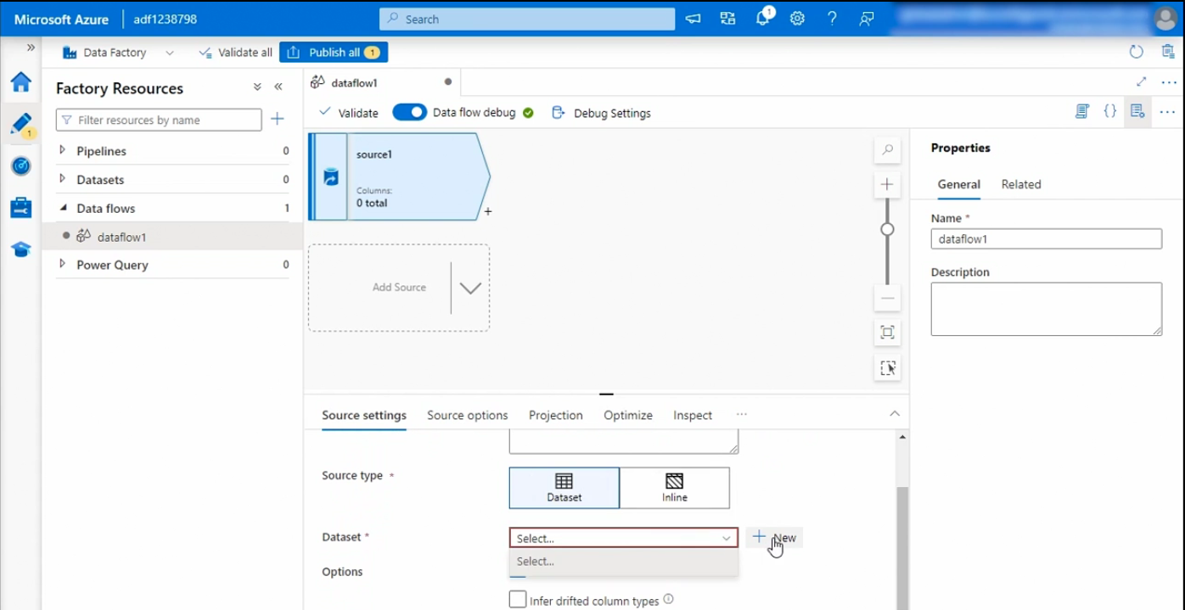

Slide 18


Slide 19
